Slide 1
Shakespearean Verse (Poetry)

Slide 2
Meter
The rhythmical pattern of a poem
The pattern of the rhythm is determined by the number of beats in each line

Slide 3
Iamb
Iamb is a pair of syllables in a line of poetry
One is stressed and one is unstressed

Slide 4
Pentameter
Verse (poetry) written in five-foot lines
Foot = a pair of syllables
Iamb + pentameter = iambic pentameter

Slide 5
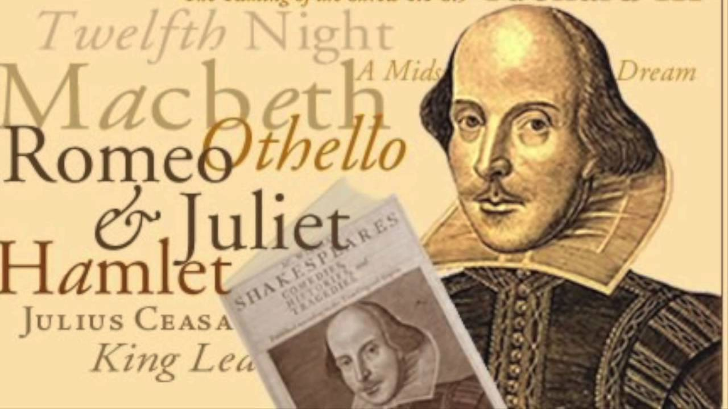
Blank Verse
Verse (poetry) written in unrhymed iambic pentameter lines
All of Romeo & Juliet is blank verse
Shakespeare often used this form of verse

Slide 6
Rhyme Scheme
The pattern of rhyming sounds at the end of each line in a poem
Each end sound gets assigned a letter in alphabetical order
If sounds rhyme, they get the same letter;
If the sound doesn’t rhyme, it gets a new letter (the next letter in the alphabet)
Let’s practice…

Slide 7
“INVITATION” (Where the Sidewalk
Ends by Shel Silverstein) If you are a dreamer, come in, If you are a dreamer, a wisher, a liar, A hope-er, a pray-er, a magic bean buyer… If you’re a pretender, come sit by my fire For we have some flax-golden tales to spin. Come in! Come in!

Slide 8
“LISTEN TO THE MUSTN’TS” (Where the Sidewalk Ends by Shel Silverstein) Listen to the MUSTN’TS, child, Listen to the DON’TS Listen to the SHOULDN’TS The IMPOSSIBLES, the WON’TS Listen to the NEVER HAVES Then listen close to me— Anything can happen, child, ANYTHING can be.

Slide 9
Try on your own…
“Oh, the Places You’ll Go” by Dr. Suess
Congratulations! Today is your day. You're off to Great Places! You're off and away!
When a new stanza starts, start your letters over again!
You have brains in your head. You have feet in your shoes. You can steer yourself any direction you choose. You're on your own. And you know what you know. And YOU are the guy who'll decide where to go.

