Slide 1
2017-2018 Program Cycle

Slide 3
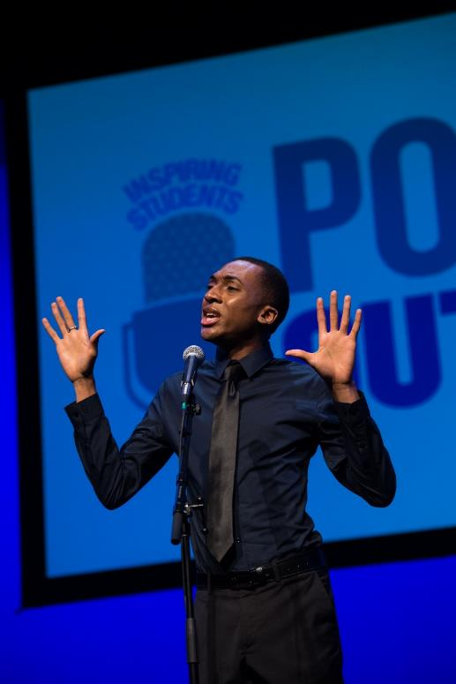
Poetry Out Loud: National Recitation Contest
Poetry Out Loud is a national arts education program that encourages the study of great poetry by offering educational materials and a dynamic recitation competition to high school students across the country.
credit: James Kegley

Slide 4
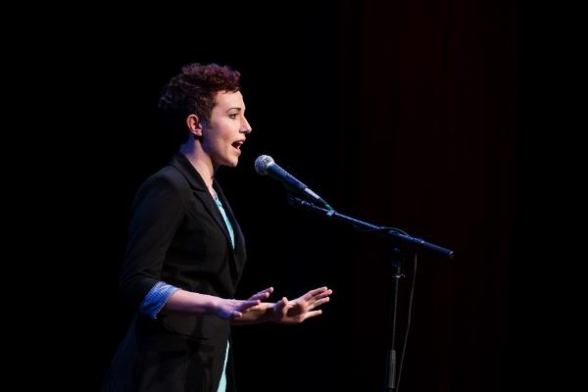
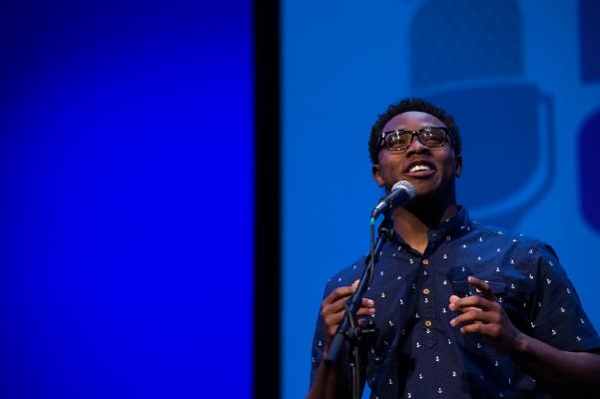
Why Was Poetry Out Loud Created?
To introduce students to classic and contemporary poetry
To address the decreasing rate of literary reading among young people
To encourage students to explore their literary heritage
To help students develop life skills such as poise and public speaking
Credit: James Kegley

Slide 5
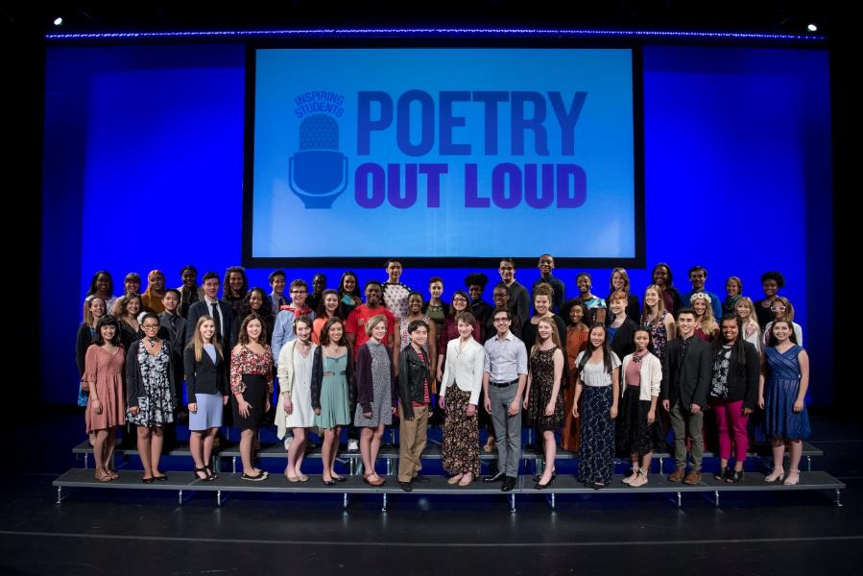
What Are The Educational Benefits For Students?
Increased literary knowledge
Improved public speaking skills
credit: James Kegley

Slide 6
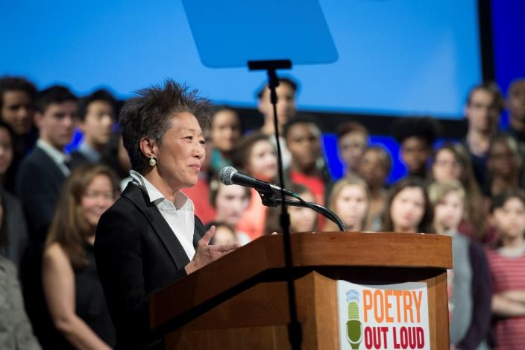
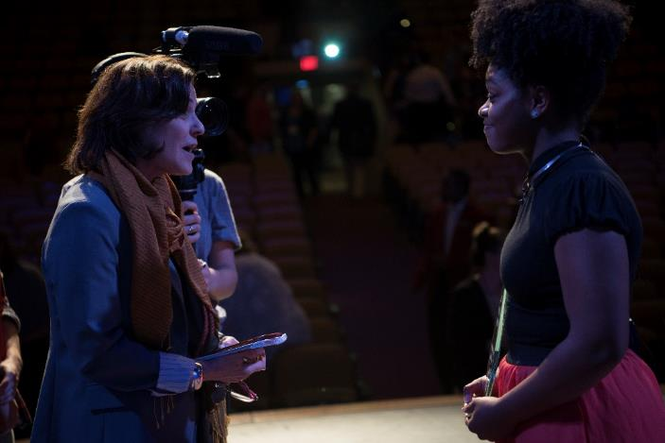
What Are The Benefits For Schools?
Positive visibility
Enhanced school spirit
credit: James Kegley

Slide 7
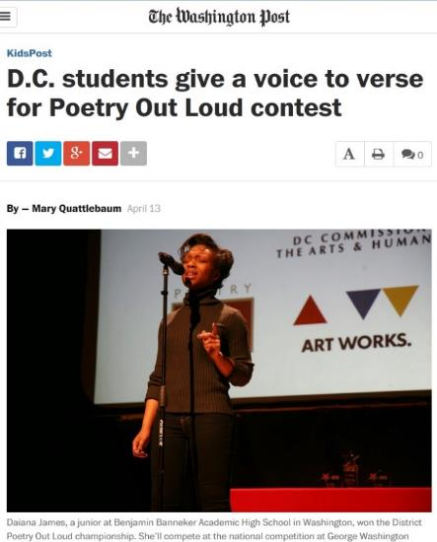
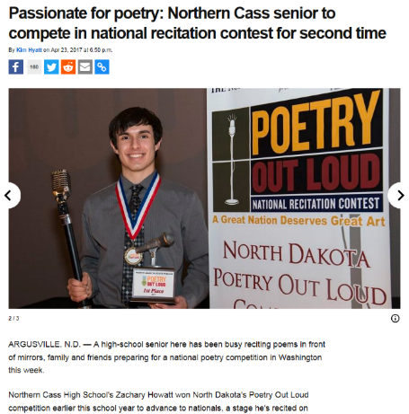
Media Coverage
Local, regional, and national media sources
Profiles of state and national champions
Success stories and tales of advancing students
News stories have reached millions since the first Poetry Out Loud contest in 2005

Slide 8
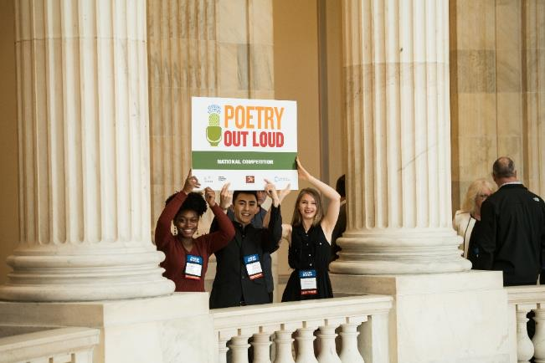
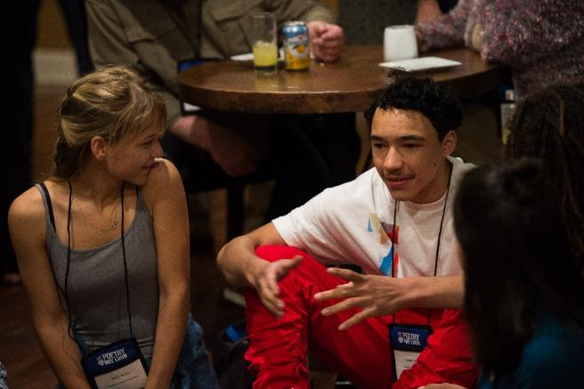
What’s The Appeal For High School Students?
Cash awards
Participation builds confidence
Students enjoy competition
Students learn from one another
credit: James Kegley

Slide 9
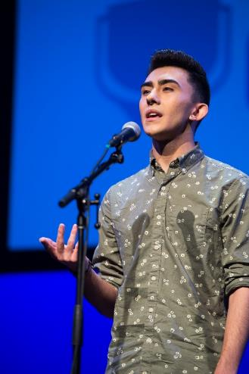
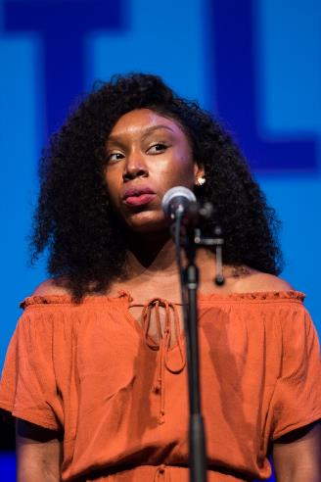
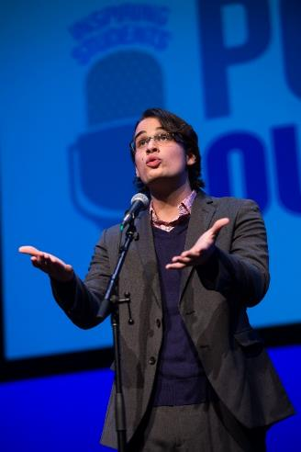
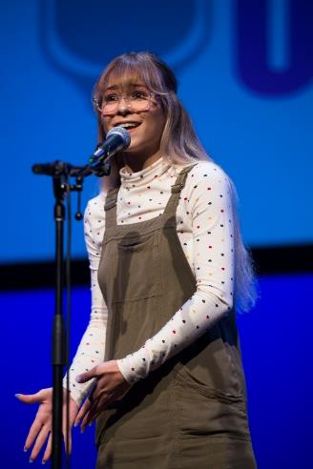
Poetry Out Loud Appeals to Many Students, All Across the Country
Tyler Ray
West Virginia
Mariah Brooks
Illinois
Nicholas Amador
Hawaii
Haley Bryan
Kentucky

Slide 10
Pyramid Structure Contest
National finals
State finals
Local contests
School contests

Slide 11
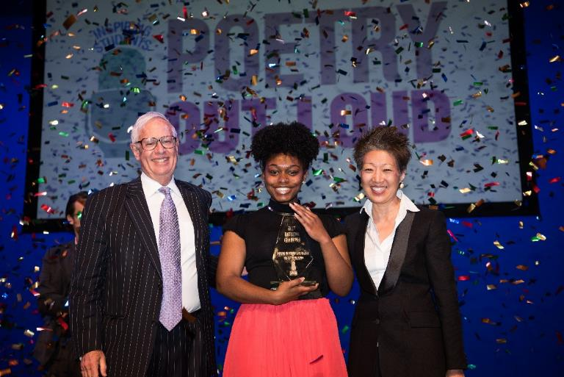
National Finals Prizes
credit: James Kegley
$20,000 for the Poetry Out Loud National Champion
$10,000 and $5,000 for the second and third place national finalists
$1,000 each for the other nine national finalists
$500 stipend for schools of top nine finalists to purchase poetry materials

Slide 12
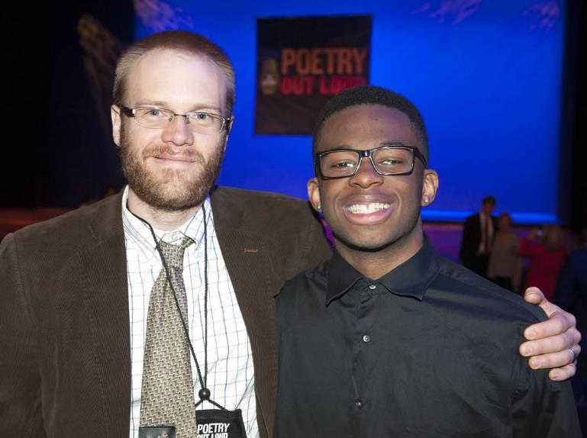
What Do Teachers Get?
NCTE & Common Core standards-based teacher’s guide
Website with resources for teachers and students
Online anthology with 900+ poems
Video examples of student performances
Posters & promotional materials
credit: James Kegley

Slide 13
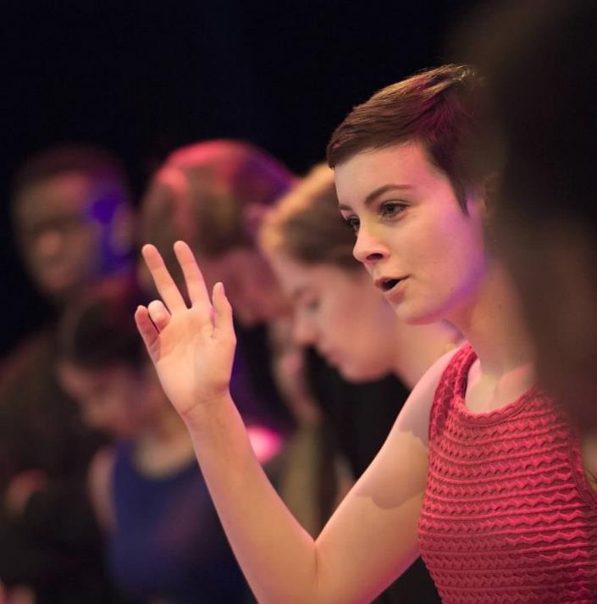
Poetry Out Loud Curriculum
Satisfies most NCTE and Common Core Standards
Lesson plans tailored to program and with creative writing exercises
Is designed to take place over 2-3 weeks
Integrates easily with existing syllabi
Can take place anytime between fall and early winter
Will not require full class periods
Credit: James Kegley

Slide 14
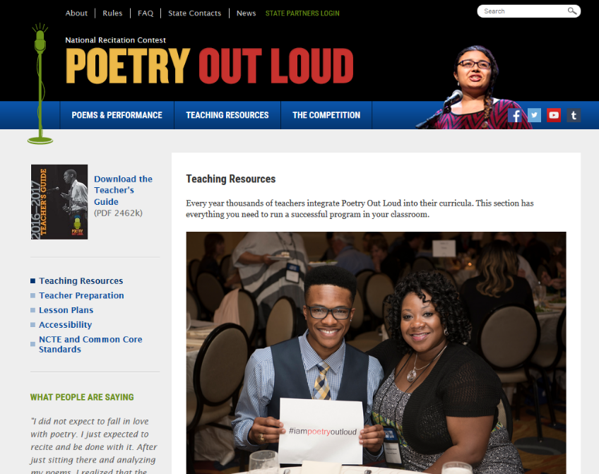
Website Tools for Teachers
Poetryoutloud.org
Poetry anthology
Teacher’s guide
Audio and video clips
Lesson plans
Judge’s guide
Tips on hosting a school contest

Slide 15
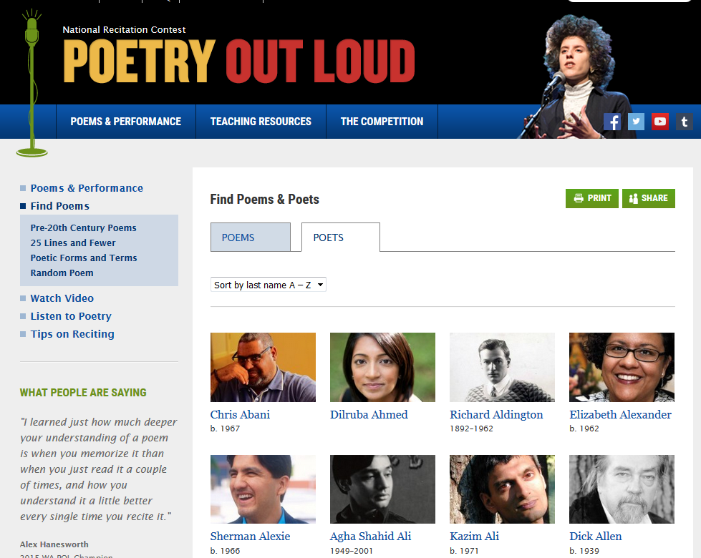
Website Tools for Students
“Find a poet” search tool
“Find a poem” search tool
Recitation practice checklist
Daily “featured poet” section with biographies and poems

Slide 16
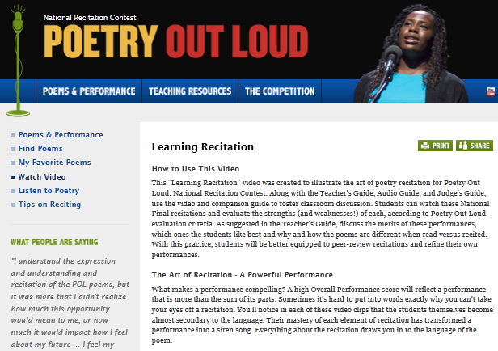
Learning Recitation Video for Teachers & Students
Learning Recitation Video shows recorded performances
Video helps students learn criteria for successful recitation techniques
Learning Recitation Video can be found online

Slide 17
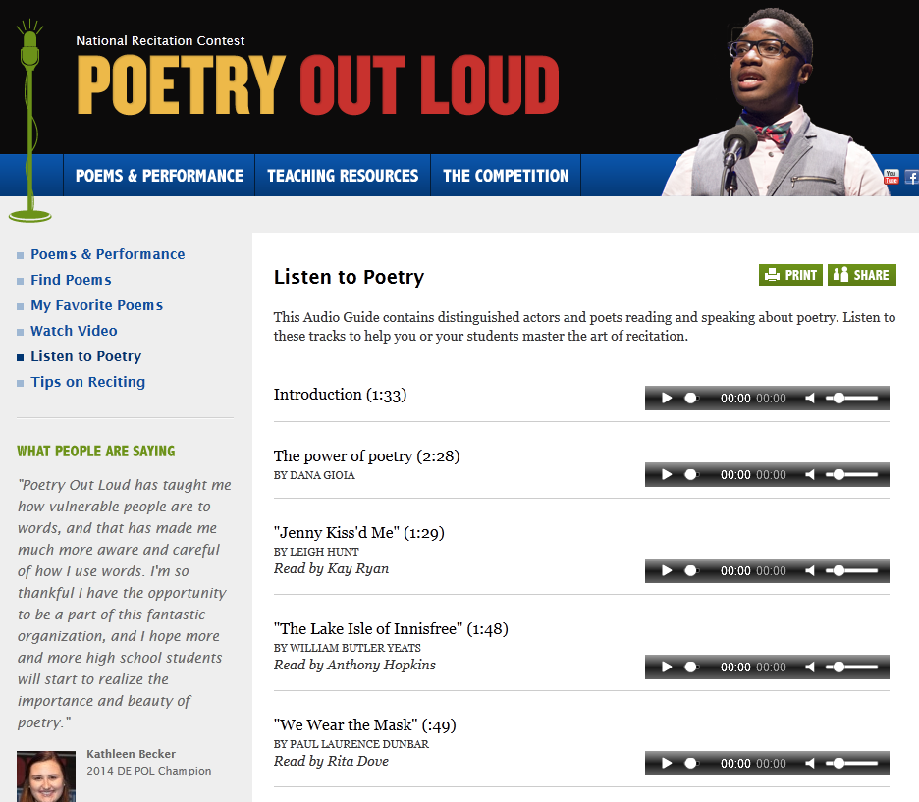
Audio Guide: Listen to Poetry
Free audio guide on performing poetry available at poetryoutloud.org
Readings by well-known actors and writers including James Earl Jones, Rita Dove, and Anthony Hopkins

Slide 18
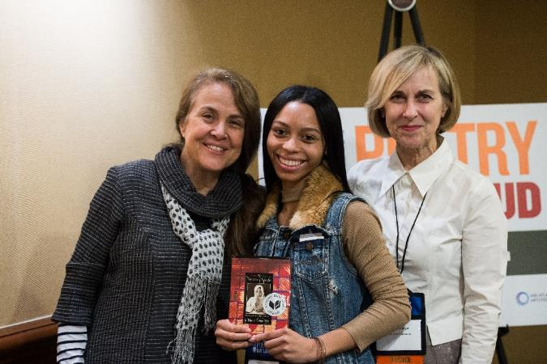
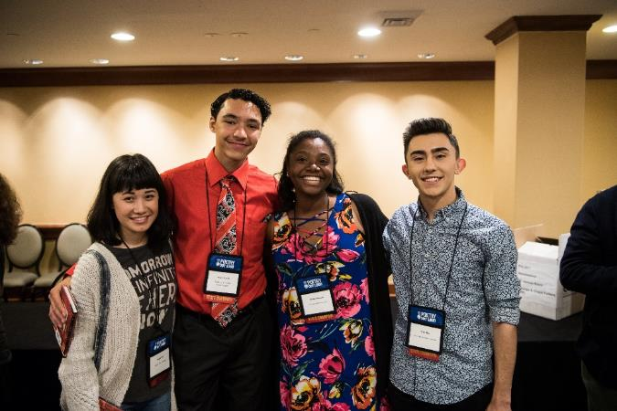
State Art Agencies’ Role
Define scope of state program
Recruit schools to participate in official state contest
Coordinate state program and state finals event
Partner with local arts organizations to administer program as needed
credit: James Kegley

Slide 19
Teacher Testimonials
“The lessons and competitions connected with Poetry Out Loud have fostered an interest in poetry that I have not witnessed before in my 16 years of teaching.”
“While I could insist that my students recite poetry without the contest, being a part of it and realizing that they're participating in something that is beyond the classroom has been a tremendous motivation for them. My students are generally thought of, and see themselves, as academic outcasts. Being a part of Poetry Out Loud has countered that perception.”

Slide 20
Student Testimonials
“I've learned that I really, really love performing even though I get nervous beforehand. Poetry isn't boring, it can make you laugh and cry all in a few stanzas. Reciting poetry allows me to use my understanding of the poem to bring it to life.”
“My language barrier developed into a drawback that stunted my social development, which led me to look for activities that would help with my language and speech skills. Poetry Out Loud has helped me in developing language speech skills, as well as delivering my feelings through an art form.”
“I feel an immense personal gratitude to Poetry Out Loud for providing me this opportunity. Naturally averse to athletics and aggressive competition, this was the first time I have been recognized at such a level, and I couldn’t be happier that it was through poetry.”

Slide 21
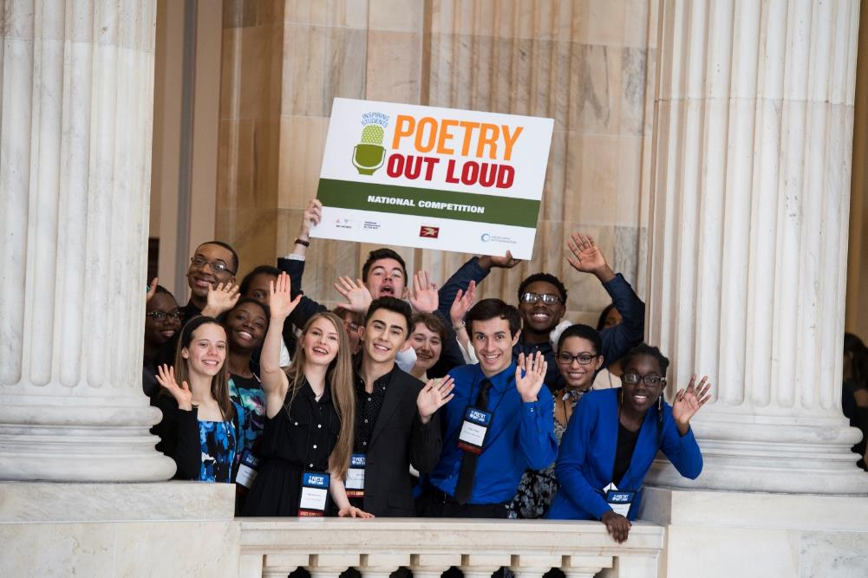
Get Involved!
Visit www.poetryoutloud.org
Contact Amy Brockman, Director of Student Life at Southwestern Illinois College at amy.brockman@swic.edu for more details on your regional contest.
credit: James Kegley

