Slide 1
Modernism
1915-1945

Slide 2
Welcome to The American Dream
Hot Dogs, Baseball, Jazz, and Money

Slide 3
Political Scene Before the War
Years preceding the war were full of optimism
Technology advances by leaps and bounds
Radio (1890s)
Skyscrapers (1890s)
Motion Pictures (1895)
Air Conditioner (1902)
Wright Brothers (1903)
Ford’s Model T and the Assembly Line (1908)
Liquid Fuel Rocket (1914)

Slide 4
Political Scene World War I
1914: War breaks out in Europe
US remains neutral
1917: US enters War on the side of the Allies
Americans are confident and optimistic, but the realities of war soon set in
Many American writers witness the war firsthand
1918: War ends
Over 100,000 Americans killed
Notes:
1915: German submarine sinks the Lusitania
Public opinion begins to sway
Lusitania: More than 1200 people die, including 128 Americans

Slide 5
Political Scene After the War
Our sense of optimism and security vanishes
Our sense of place and comfort has been disturbed
America goes through a process of “binging” and “purging,” as we struggle to define ourselves in an ever-changing world
Do we celebrate or moderate?
Do we spend or save?
Should we feel relieved or lucky?
Do we cling to old values or invent “modern” ones?

Slide 6
Social Scene
The result is an almost maddening mixture of prosperity and depression, liberation and repression, excitement and fear
1919: Prohibition (18th Amendment)
1920: Women’s Suffrage (19th Amendment)
1920: More Americans now live in urban areas than in rural
1929: St. Valentine’s Day Massacre
1933: Prohibition repealed (21st Amendment)
1915-1930: The Great Migration
Over two dozen riots in 1919—the “Red Summer”
Notes:
Prohibition: leads to underground industry of bootlegging and speakeasies, as well as the rise of the mob
Great Migration: 1.5 million African Americans migrate from South to North (1 in 7 of the AA pop)
1917 East St. Louis Race Riot: Over a month of violence and over 100 dead
1919 Chicago Race Riot: 8 Days, 500 Wounded, 38 Killed

Slide 7
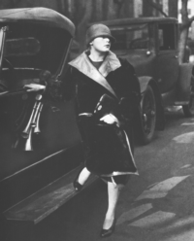
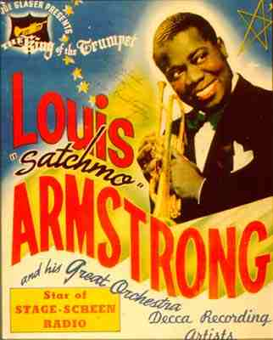
1920s: America “Binges”
Economic Boom
Urbanization and Vertical Cities
Radio Arrives
Hollywoodland
Fashion Fads
Artists Flock to Greenwich Village
New Music: Jazz
Notes:
The Great Gatsby

Slide 8
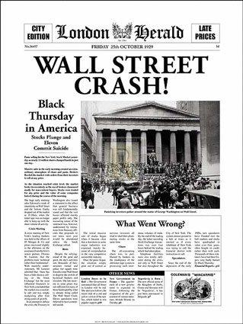
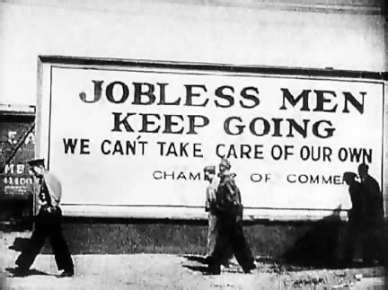
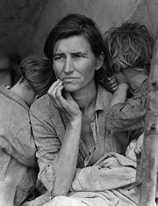
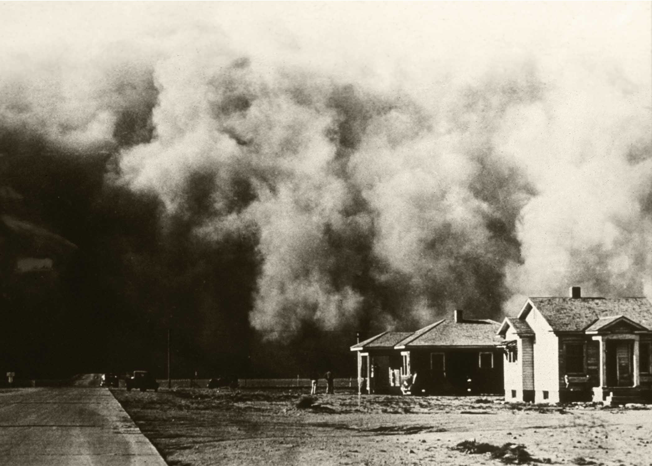
1930s: America “Purges”
1929: Stock Market Crashes
A Decade-Long Depression
1930: Drought
1934: Dust Bowl
US Won’t Recover Until WWII
Notes:
Dust Bowl: Drought, Wind, and Lost Topsoil
Americans once again took to the trails for a better life: Grapes of Wrath

Slide 9
Literary Scene
From this social rollercoaster Modernism is born
Two different forces shape our literature
Recklessness and liberation of the “Roaring” ’20s
Hopelessness and tragedy of the Great Depression and 1930s
No longer satisfied with “re-creating” (as with Realism), Modernists want to “create” something new, to invent a new literature for a new country and new world

Slide 10
Modernists experiment with style and technique
There is no uniform set of characteristics to box them in, and nothing is off limits: narrative, dialogue, punctuation, theme
If anything it is the ambiguity and relativity with which authors approach formerly traditional characteristics of literature that defines Modernism: the reader is rarely told what to think anymore, but rather must interpret both characters and events for himself
Despite diversity, Modernists did share a common vision:
They seek to capture the essence of “modern” life . . . not only in the content of their work, but also in its form
Notes:
Having never won a Nobel Prize for Literature, Americans take home the award in 1930, 1936, 1938, and in 1948, 1949, 1954, and 1962 for work produced largely during this time

Slide 11
Modernism
Traditional plot is sometimes abandoned
Themes are implied, rather than stated directly
Characters are morally ambiguous
Conclusions are often left open-ended
All of this forces readers to come to their own interpretive understanding of a book

Slide 12
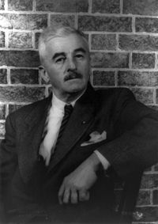
Faulkner: A Lesson in Experimentation
Caddy held me and I could hear us all, and the darkness, and something I could smell. And then I could see the windows, where the trees were buzzing. Then the dark began to go in smooth, bright shapes, like it always does, even when Caddy says that I have been asleep. —The Sound and the Fury (1929)
I am I and you are you and I know it and you dont know it and you could do so much for me if you just would and if you just would then I could tell you and then nobody would have to know it except you and me and Darl. —As I Lay Dying (1930)
Notes:
Stream-of-consciousness: tries to mimic the internal flow of thought, allowing readers inside the minds of characters

Slide 13
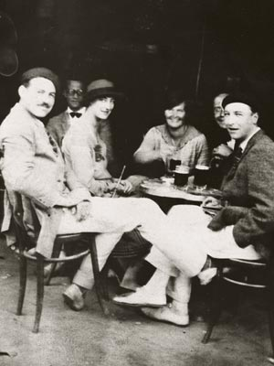
“The Lost Generation”
Postwar disillusionment leads several writers to abandon the US
Gertrude Stein, Sherwood Anderson, Fitzgerald, and Hemingway all spent important parts of their careers in France
Ezra Pound and T.S. Eliot spent most of their lives in England
This “Lost Generation” saw America as a declining civilization and looked to Europe as the cradle of art and culture

Slide 14
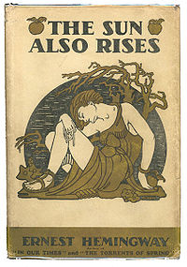
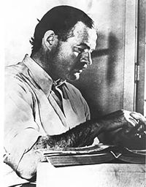
Hemingway: A Lesson in Ambiguity
“Well, how did you like the bulls?” he asked.
“Good. They were nice bulls.”
“They’re all right”—Montoya shook his head—“but they’re not so good.”
“What didn’t you like about them?”
“I don’t know. They just didn’t give me the feeling that they were so good.”
“I know what you mean.”
“They’re all right.”
“Yes. They’re all right.”
“How did your friends like them?”
“Fine.”
“Good,” Montoya said.
I went upstairs. —The Sun Also Rises (1926)
Notes:
How many times are things described as “good” or “fine?”
What does that mean? How do these characters feel?
Sounds like a conversation between you and your parents when you come home from school, doesn’t it?
To understand what is really being said, you must read between the lines and understand the characters.
Hemingway’s “simplicity” is deceptive; nothing is truly given directly.

