Slide 1
Welcome to the American Dream
Hot Dogs, Baseball, Jazz, and Money

Slide 2
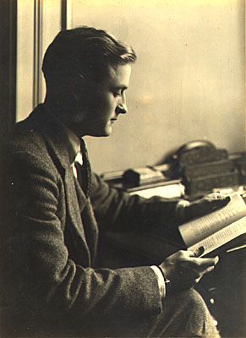
F. Scott Fitzgerald
1896-1940
Born in St. Paul, Minnesota
The great chronicler of The Jazz Age
Leaves Princeton to join the Army in 1917
Meets Zelda Sayre—beautiful, talented, and wealthy
This relationship provides a foundation for many of his novels
Becomes an overnight sensation with This Side of Paradise (1920)
The Beautiful and the Damned (1922)
The Great Gatsby (1925)
Dies in the grip of alcohol and depression, believing he’s forgotten
Notes:
Jazz Age: glamour, recklessness, hedonism—the titles clearly reveal this
Princeton party boy—jumping into fountains, drinking, all-night orgies
“The Curious Case of Benjamin Button” (1921)

Slide 3
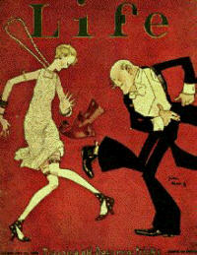
His novels tend to explore a particular theme
A surface of wealth, glamour, and privilege
An undercurrent of deception, depression, and insecurity
Some scholars say that our notion of the American Dream can be traced to the many themes and ideas of this one book
Rags to Riches Story
Myth of the Self-Made Man
Triumph of Capitalism
Romance of “Stuff”
“Only In America” Attitude
A Fresh Start; A New Beginning; A New Identity
Notes:
Fitzgerald and Zelda understood the rich and famous and beautiful because . . . they were

Slide 4
The Great Gatsby
Published 1925
The “Great American Novel”
A Perfect Reflection of Its Age
A Tale of
Myth
Romance
Illusion
In Short—An American Tale
Notes:
In this novel we witness America

Slide 5
People to Watch
Nick Carraway: Originally from the Midwest, Nick is the narrator of the novel and neighbor to Gatsby
Jay Gatsby: Mysterious and elusive millionaire (“new money”), we learn about Gatsby primarily through others
Daisy Buchanan: Cousin to Nick and wife of Tom
Tom Buchanan: Arrogant, insecure, and racist, Tom (who comes from “old money”) is the husband of Daisy and neighbor to Gatsby
Jordan Baker: Daisy’s longtime friend

Slide 6
Things to Look For
Symbolism
The “green light”
The eyes of Doctor T. J. Eckleburg
Motifs
“Old sport”
Yawning
Second-hand news
Paradoxical or Implausible sentences
Tone and Style
The “dim and hazy,” boozy, almost surreal feel of the book, the characters, and this entire era

Slide 7
It’s All about Belief
Belief is the controlling force behind this story
The ability to persuade others to believe
Our desire—in many cases, our need—to believe
Reality rests not on truth, but on what we believe to be true
Belief shapes our identity and our destiny
What we believe happened in the past
What we believe we are experiencing in the present
What we believe we can have in the future
Belief is at the center of the novel’s biggest paradox: Gatsby believes that he can both escape and recapture his past at the same time. But are we any different?
So we beat on, boats against the current, borne back ceaselessly into the past.

Slide 8
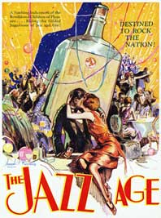
Chapters 1-3: Myth Who Is Jay Gatsby?
Mysterious and elusive
German Spy?
Bootlegger?
Oxford Man?
Owns a great mansion in West Egg
Throws elaborate parties
We learn about Gatsby primarily through Nick, the narrator of this story
there was something gorgeous about him, some heightened sensitivity to the promises of life … an extraordinary gift for hope, a romantic readiness such as I have never found in any other person…
Notes:
Gatsby is mythological in status
He has multiple stories of origin
West Egg, Long Island is a fiction
Parties: dancing, drinking, singing, swimming, orgies of every kind

Slide 9
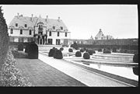
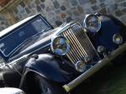
Is Gatsby a 20th century Ben Franklin?
Self-Made Man
Rags to Riches
A man who crafts and sculpts his life into a great success
But Gatsby’s story is very different from Franklin’s prescribed plan of hard work, moderation, and virtue
Gatsby constructs himself out of magic, mirrors, and smoke
Notes:
How? Gatsby is more sinister and conniving, and builds his success on an illusion
Why? Gatsby’s primary motive is love
In his deception of others, he eventually deceives himself; he believes the lie

Slide 10
Chapters 4-6: Romance What Does Gatsby Want?
Everything Gatsby is, everything Gatsby does, is to recapture one singular lost moment from his past
It is on that one moment that his future hinges
It is in that one moment that his present is defined
What drives Gatsby?
Money? Ambition? Hope? Nostalgia? Love? Acceptance?
Has he achieved the American Dream?
What defines the American Dream?
Notes:
Romance: a colorful but baseless, made-up story, usually full of exaggeration or fanciful invention
The final line reflects this: So we beat on, boats against the current, borne back ceaselessly into the past
Gatsby: Beautiful house, beautiful clothes, beautiful people, beautiful wife
What drives American Dream: Capitalism? Materialism? Consumerism?

Slide 11
Chapters 7-9: Illusion Can the Romance Survive Reality?
Is the American Dream a reality?
Or is it the chase that fascinates us and occupies a lifetime?
Is the American Dream a lie?
Does it exist outside the what we hear, read, and see in the media?
Can the “dream” survive the “reality”?
Can reality ever live up to our dreams?
And if so, can we sustain it?
Or is the American Dream simply an American Illusion?
Notes:
The Chase: Wanting drives us more than having
Lie: Movies, TV, Books, Celebrity Culture, Hollywood—is this an accurate reflection
Deception: Advertisement and Celebrity Culture—is it purposeful and do we buy it
Can our reality ever live up to our dreams? How many people have accomplished such a feat?
The romance of “stuff”
Nostalgia and Romance
Style vs. Substance

